Slide 1
Oppositional, Defiant & Disruptive Children & Adolescents
Non-Medication Approaches to the
Most Challenging Behaviors
Robert Marino

Slide 2
Agenda
Session #1
Disorders, assessment and treatment strategies
The power of accurate praise and correction
Techniques for the cognitive processing and enhancing
perspective taking
Targeted strategies for specific behaviors
Special Circumstances

Slide 3
ODD and Co-occurring Disorders
Oppositional Defiant Disorder
Conduct Disorder
Attention Deficit Hyperactivity Disorder
Disruptive Mood Dysregulation Disorder
Trauma and Stressor Disorders
The causes are often distinct but the presenting problems are often very similar. Treatment strategies can be very different.

Slide 4
Appointment Clock
Appointment #1
____________
Appointment #2
______________
Find Two of your peers from around the room and write their names in each of the appointment times. At designated times during the presentation today you meet with each appointment to complete a task.

Slide 5
Treatment Manuals/Approaches
Cognitive Behavior Therapy
Functional Behavior Assessment and Behavior Intervention Plans
Anger Management
Relationship Coaching
Methods Multi-Modal
Treatment Interventions
Parent Training
Community Collaboration

Slide 6
Common Elements
Evidence Based Practice Manuals
Common Elements
Select a treatment manual
Use the same techniques at the same level of intensity with each client
Clinician must maintain fidelity to the treatment manual
Select practice elements known to be effective from manualized treatments
Common elements vary based on client needs, response, current presenting issues
Clinician must maintain fidelity to the steps of the common element

Slide 7
DSM V Descriptors,
New Chapter
Disruptive , Impulse Control and Conduct Disorders, emotional and behavioral self control
ODD
Three symptom clusters
Angry/irritable, argumentative/defiant, Vindictiveness
Severity and Frequency,
Conduct Disorder
Can be a developmental outcome of ODD
Limited pro-social behaviors
Intermittent Explosive Disorder
Broaden criteria, impact issues, impulse and anger based

Slide 8
Anger and Hostility Assessment Anger Regulation and Expression Scale
Unpacking Anger Expression
Internalized Anger Arousal ,Psychological Arousal, Cognitive Arousal, Rejection, Anger-In, Bitterness, Resentment, Suspiciousness
Externalized Anger, Overt Aggression , Physical Aggression , Verbal Aggression, Covert Aggression, Revenge, Bullying, Impulsivity, Subversion, Relational Aggression, Passive Aggression
Extent of Anger, Scope of Triggers, Problem Duration, Episode Duration

Slide 9
Activity #1 Match Criteria to Anger
Looking at the Anger Regulation and Expression Scale, match the subgroup to the component
ODD Subgroups
Anger Regulation and Expression Scale Components
Angry/irritable (A/I)
Argumentative/defiant(A/D)
Vindictiveness (V)
Severity
Frequency
Duration
Arousal ,Psychological Arousal, Cognitive Arousal, Rejection, Anger-In, Bitterness, Resentment, Suspiciousness
Overt Aggression , Physical Aggression, Verbal Aggression, Covert Aggression, Revenge, Bullying, Impulsivity, Subversion, Relational Aggression, Passive Aggression

Slide 10
Conduct Disorder
A descriptive specifier was added
Meet criteria but also have limited pro-social emotions
Opens the door to pro-active treatment focused on pro-social emotions.
“An emotion is pro-social if it induces an agent to act in ways that increase the average payoff to other members of a group to which the agent belongs. Name some additional pro-social emotions

Slide 11
Promoting Pro-Social Emotions
Punishment can cause shame but with conduct disorders it causes spite. How do we change spite to shame? Fairness. Does change due to punishment mean success?
Interventions should focus on creating Pro-Social behaviors with a bigger pay off.

Slide 12
What can CBT do for IED McCloskey Et. al. 2008
Cognitive Restructuring, Relaxation and Coping Skills Training (CRCST)
Anger
Hostile thoughts
Anger Expression
Anger Control
Reduced Depression
Improved Quality of Life

Slide 13
Evidence-Based Treatments for Disruptive Behavior
Parent Training
Social Skills Training
Cognitive Behavior Therapy
Assertiveness Training
Communication Skills
Anger Management
Relaxation Training

Slide 14
Attention Deficit Hyperactivity Disorder
Placed in the neurodevelopmental disorders chapter
Focuses efforts on brain based interventions
What are brain based interventions
The brain is use dependent
Computer assisted interventions
Executive Functioning improvement
Turning the brain on
Modeling, training, examples
Involving physical and language processing

Slide 15
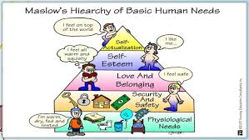
Intervention-Teach Emotional Regulation
Brautigan’s Karma Repair Kit
Emotional Vocabulary
Emotional Intelligence
Practice, Practice, Practice
Emotional Regulation Games http://harvardmagazine.com/2011/01/gaming-the-emotions, Playmancer, http://www.youtube.com/watch?v=osmo9EAClv8

Slide 16
Treatment Strategies
TF-CBT http://tfcbt.musc.edu/
Free online Professional Development
Psycho-education
Stress Management
Affect Expression and Modulation
Cognitive Coping
Creating the Trauma Narrative
Cognitive Processing
Behavior Management Training
Parent Child Sessions

Slide 17
Stress Management
Controlled Breathing
Explain rationale, Demonstrate, Introduce relaxation word, Have child demonstrate
Relaxation Training
Explain rationale, get comfortable, demonstrate, practice
Thought Stopping
Explain rationale, demonstrate, choose method, introduce replacement thought, Have child demonstrate, practice
Scheduled practice because stressed people are often poor planners

Slide 18
Affect Expression and Modulation
Explain rationale for feelings identification
Have the child identify as many feelings as possible (Emotional Vocabulary)
Teach the child how to rate the intensity level of an emotion
Teach the child how to express feelings appropriately in various situations
Differentiate based on cognitive and language skills

Slide 19
Tiered Chocolate Activities
Make a list of descriptive, sensory and/or comparative feeling words to describe your chocolate.
Create a SIMILE to help someone understand how you feel about your chocolate.
Chocolate is like a smooth silky river.
Create a warning label to attach to your chocolate.
Alert! Chocolate can cause…
Finish this analogy:
Chocolate is to happiness as _________ is to confidence.
Notes:
ALLOW 15 Minutes
At your table, there is an envelope with 6 different activities, centered around the key concept “Attributes of Chocolate”.
Take a moment to make sure you all know what is in the envelope and then divide the cards so everyone at your table has a different activity.
Take two minutes to complete your activity independently. You may write directly on the card.
After 2 minutes…..
Move to assigned groups to compare your work to others who worked on the same activity. Before we conclude, tables will share out responses. (Designate where in the room each group will meet to share their common activity.)
Share out several responses.
Sample questions for whole group:
Did any of you work on an activity with which you weren’t comfortable?
Is it ok for teachers to assign a tiered activity to a student? Why or why not?
What would a teacher do if he/she realized they had assigned the inappropriate level of work to a student?
What if a student does something totally unrelated to the attributes of chocolate?

Slide 20
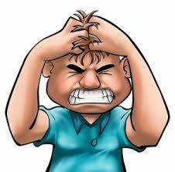
Tiered Feeling Activities
Make a list of descriptive, sensory and/or comparative feeling words to describe your Anger.
Create a SIMILE to help someone understand how you feel about your Anger.
My anger is like an erupting volcano.
Create a warning label to attach to your anger.
Alert! My uncontrolled anger can scare my friends away.
Finish this analogy:
Anger is to stress as __________ is to control.
Notes:
ALLOW 15 Minutes
At your table, there is an envelope with 6 different activities, centered around the key concept “Attributes of Chocolate”.
Take a moment to make sure you all know what is in the envelope and then divide the cards so everyone at your table has a different activity.
Take two minutes to complete your activity independently. You may write directly on the card.
After 2 minutes…..
Move to assigned groups to compare your work to others who worked on the same activity. Before we conclude, tables will share out responses. (Designate where in the room each group will meet to share their common activity.)
Share out several responses.
Sample questions for whole group:
Did any of you work on an activity with which you weren’t comfortable?
Is it ok for teachers to assign a tiered activity to a student? Why or why not?
What would a teacher do if he/she realized they had assigned the inappropriate level of work to a student?
What if a student does something totally unrelated to the attributes of chocolate?

Slide 21
Six Steps to Emotional Literacy
Identify feeling words in daily activity
Relate word to student personal experiences
Associate the word with a color or design or picture or animal
Relate the word to current topics
Homework, have students involve parents in learning the word
Group discussion of the word
Make the word a spelling word and use the word in a writing assignment 1 word per week =32 new words in a school year

Slide 22
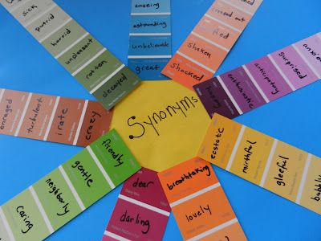
Expanding Emotional Vocabulary
Emotional literacy opens the door for the expression of feelings and appropriate social interaction.

Slide 23
Activity #2 Paint Sample Cards Activity
Examine Feeling Chart
Examine paint chips and feeling words
Create your own paint chip
What else did you think of while doing this?

Slide 24
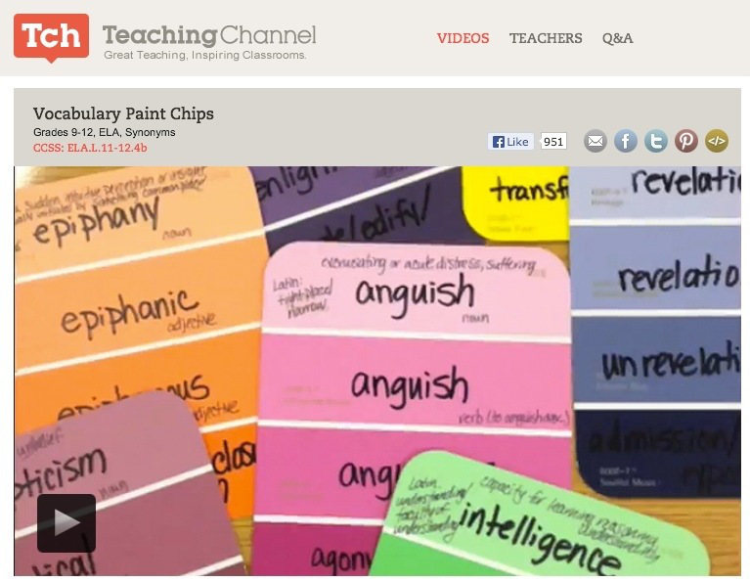
Paint Chip Vocabulary
Handout 1
Provide students with paint chips with feeling words
Students use one form of the word during a lesson, class discussion or when writing.
Paint Chip Words

Slide 25
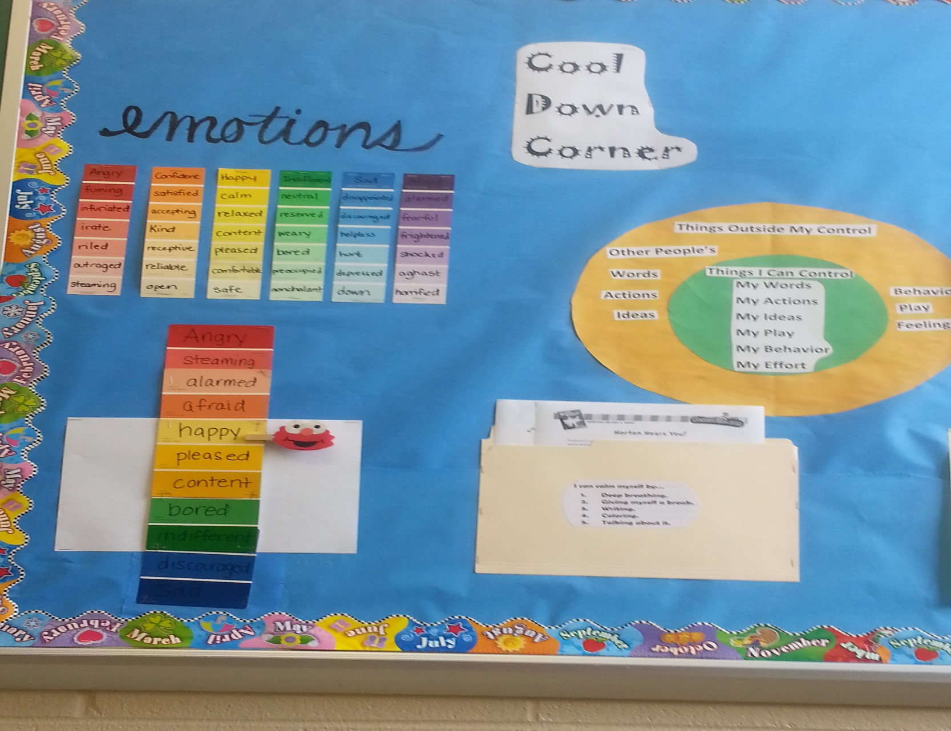

Slide 26
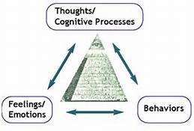
Cognitive Coping
Review difference between thoughts and feelings
Outline the "Cognitive Triangle” connect thoughts to feelings and behavior
Use example to explain how thoughts affect behavior.
Generate scenarios and have child identify thoughts, feelings, and likely behaviors.
Help child generate more accurate or helpful thoughts
Differentiate instruction
Discuss how to apply this skill to real life

Slide 27
Emotional Regulation
The advent of the fMRI has allowed us the view the brain at work during a variety of demands, including emotional stress, reaction, and the cognitive processing of emotion.
Follow-up activity-Read handout on Emotional Regulation
How might understanding the physiological foundations of regulation assist in intervention?

Slide 28
Gayle Macklem Emotional Regulation
Domains of emotional regulation
Controlling input (sensation)
Information processing (what do I think, or feel about what happened?)
Response selection (what do I do now?)
This is a fast acting sequence

Slide 29
Emotional Intelligence in the Classroom: Skill-Based Training http://heblab.research.yale.edu/pub_pdf/pub101_BrackettKatulak2006TheEIclassroom.pdf
Skills
Perception of emotion
Use of emotion to facilitate thinking
Focus attention, improve reasoning and decision making
Understand emotional information
What are the causes of emotion and how do they change
Management of emotion
Employ emotional strategies

Slide 30
29
Artful Thinking Routines

Slide 31
Characteristics of Artful Thinking Routines
Handout 30
Promotes children’s abilities to solve problems, analyze
knowledge, generate insights, use their imagination and
curiosity, synthesize new relationships between ideas, and
make meaningful connections across events.
Engages the child in active learning and social problem solving.

Slide 32
Reasoning Routine What Makes You Say That?
Reasoning routines accentuate the child’s ability to make reasonable interpretations of ideas or information. Children will be able to more accurately describe what they are seeing and how to explain their thoughts and ideas.

Slide 33
Reasoning Routine What Makes You Say That?
What is happening in this picture ?
What makes you say that?
What evidence is there?

Slide 34
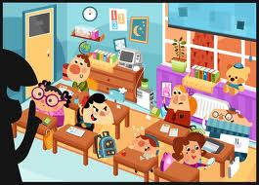
A Reasoning Routine Claim/Support/Question
Make a claim about the picture
Identify support for the claim
Ask a question related to the claim
Identify and explain, provide evidence for your opinion

Slide 35
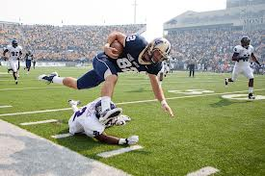
Perspective Taking Routine Circle of View Points
Make a list of perspectives
2. Consider the following statements:
I am thinking of ____________
from the point of view of
the_________.
I think_____________________
(describe the topic from your point of view)
3.A question I have from this view point is______________.
Responsibility pie chart

Slide 36
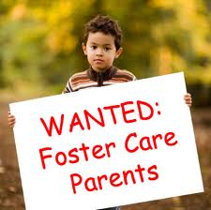
Observing and Describing Routine Listening/Looking Ten Times Two
Look at the image for 30 seconds
to one minute. Look at the entire
image.
2. List 10 words/phrases about any
aspect of the image
Repeat step one. Look again and
try to list ten additional words or
phrases that come to mind as you
view the image.

Slide 37
Artful Thinking Routines
Discussion:
How likely is it for you to incorporate these techniques into your approach?
Assess supports
Assess obstacles

Slide 38
Behavior Management Parent Training
Provide psycho-education to parent
Teach parents how to use
Praise
Active ignoring
Timeout
Practice with parents using role play

Slide 39
Parent Management Training
Parent management training
Parent management training (PMT) is an adjunct to treatment that involves educating and coaching parents to change their child's problem behaviors using principles of learning theory and behavior modification .
Good coaching always involves practice and progress monitoring. Read more: http://www.minddisorders.com/Ob-Ps/Parent-management-training.html#ixzz3Ss8L9OMU

Slide 40
Kazdin Parenting the Defiant Child
Praise matters most
Components
Enthusiastic
Specific to child’s behavior
Non-verbal as well as verbal
Conditions
Make the link between praise and the behavior strong
Praise is delivered right after the behavior
Increase frequency create more opportunities

Slide 41
Parent Child Sessions
Assessing the parent's readiness
Is the parent emotionally ready?
Does the parent have the ability to actively support the child?
Does the parent have any specific or unique concerns?

Slide 42
Relationship Coaching
Peer rejection and social isolation can contribute to continued symptomatology in children with ODD and co-occurring conditions
Extensive research is being conducted at the
Peer Relationships in Childhood Lab
http://www2.psych.ubc.ca/~mikamilab/

Slide 43
Essential Components Mikami
Build or strengthen a positive relationship first
Engage in an activity without, directing, teaching or criticizing
Focus on one or two crucial behaviors
Listen for ten minutes before making suggestions
Give effective praise and suggestions
Focus on improvement from baseline
Give specific praise, don’t spoil it
Teach child how to give praise

Slide 44
Essential Components
Help the child identify good friendship choices
Someone who already likes him/her
Share common interests
Will be a good influence (Works Both Ways)
Know the difference between correction and constructive suggestions
Ration of praise to suggestions 4-1
Given in private, be calm,
Stay focused on behavior and current event, not the past or personal characteristics

Slide 45
Oppositional, Defiant & Disruptive Children & Adolescents Part II
Non-Medication Approaches to the
Most Challenging Behaviors
Robert Marino

Slide 46
Agenda
Session #2
Disorders, assessment and treatment strategies
Disorder informed FBA/BIP
System – wide approaches
Targeted strategies for specific behaviors
Special Circumstances

Slide 47
FUNCTIONAL BEHAVIORAL ASSESSMENT AND BEHAVIOR INTERVENTION PLANS

Slide 48
What is a FBA? (Data and History)
A Functional Behavioral Assessment (FBA) is a systematic method of collecting data to understand why a student misbehaves. An accurate understanding of the purpose of the inappropriate behavior is critical if teams are to design interventions that are effective in changing the behavior.
In a clinical approach, this is your background, history, and current status data in reference to the presenting problems

Slide 49
What information will you gain from completing a FBA?
In what settings or under what conditions is the behavior most likely to occur?
In what settings or under what conditions is the behavior least likely to occur?
What are the functions of the behavior(s)?

Slide 50
Common Functions of ODD Behaviors
Control
Reduction of Anxiety
Avoidance
Escape

Slide 51
Behavioral Assumptions…
The underlying assumption of an FBA is that all behavior occurs for a reason. In the case of problem behaviors, they usually persist because they:
Are effective and efficient in getting the student what he or she needs;
Were effective at one time; or
Are effective in other environments.

Slide 52
Objectives:
Develop Behavioral Intervention Plans (Treatment Plans)that address hypothesized function of behavior
Write Behavioral Intervention Plans that address skill and performance deficits
Determine how and when to modify antecedents and consequences
Write Behavioral Intervention Plans that identify responsible implementers
Appropriately monitor progress on Behavioral Intervention Plans
Identify recommended methods of measuring progress and trouble-shooting Behavioral Intervention Plans.

Slide 53
Addressing Skill Deficits
Does the student perform the desired behavior in other settings?
Does the student understand the expectations of the setting?
Is it within the student’s ability to control the target behavior?
Does the student have the skills to perform the replacement behavior?
Can the student identify when the replacement behavior is required?
If the answer to these questions is no then the behavior is probably due to a skill deficit.

Slide 54
Addressing Performance Deficits
If the Functional Behavioral Assessment reveals that the student has the skills necessary to perform the behavior(s), but does not consistently use them, the behavior(s) is considered a performance deficit. In this case, the intervention plan may include techniques, strategies, and supports designed to increase motivation to perform the skills.

Slide 55
Lizzie
Lizzie is typically a pleasant and cooperative student, but there are times that she can become frustrated. When working in a group, Lizzie can become easily agitated if the other students don’t allow her to do what she wants or if she perceives the task as too challenging. When she becomes agitated, she may shout profanities at her peers and has shoved or pushed them out of a chair and onto the floor. On one occasion, the teaching assistant tried to assist Lizzie by placing a hand on her shoulder. When she was touched, Lizzie turned around quickly and dug her nails into the assistant’s arm and scratched her.

Slide 56
Activity
Lizzie- Performance or Skill Deficit?

Slide 57
Components of a BIP (Treatment Plan)
A well-written BIP has measurable goals, which are clearly written and describe projected improvement or remediation for the inappropriate behavior(s), and are directly related to the student’s present level of performance.
Identified schedule for monitoring of progress towards the plan’s goals.
Monitoring and progress notes.

Slide 58
Step One: Deciding on a Target Behavior
Most children have more than one behavior that is problematic.
Dangerous behaviors are addressed first
When deciding on which behavior to address first, teams should consider the severity and frequency of the behavior(s). Address dangerous behaviors as a first priority
When making this determination, teams may want to chart behaviors on a Severity of Disruptive Behavior Chart.

Slide 59
Severity of Disruption

Slide 60
Step Two: Choosing Replacement Behavior(s)
When a replacement behavior(s) is suggested the following questions should be considered.
Does the replacement behavior(s) satisfy the same function(s) (or need) as the problem behavior(s) or result in the same outcome?
Is it more reinforcing for the student to engage in the replacement behavior(s) than the problem behaviors(s)?
Is the replacement behavior(s) something the student can and will do?
Is the replacement behavior(s) something the child does in other settings?
Are there any negative side effects of the replacement behavior? Assess the trade off.

Slide 61
Replacement Behaviors
The goal statement for the replacement behavior(s) should include an exact statement of the required behavior(s), a time limit or an indication of how many prompts are needed to elicit the replacement behavior(s), and the amount of assistance required to meet the goal.

Slide 62
Example
Target behavior:
Bob acts out at the beginning of class in order to avoid work.
Incomplete goal statement for replacement behavior
Bob will do an alternative task until his teacher is able to assist him with his assignment.
Complete goal statement for replacement behavior
Bob will finish taking the class roll, independently within ten minutes of the start of class.

Slide 63
Step Three: Selecting Interventions Three Broad Categories
Positive Strategies
Rewards program
Program Modifications
Shortened class schedule – Order of demands
Supplementary Aids and Services
Participation in weekly small group sessions

Slide 64
Interventions for students who lack intrinsic motivation
Reward appropriate behavior through behavioral contracts or token economies and other interventions that include peer and family support may be necessary in order to change the behavior(s).
Extrinsic rewards, i.e. food, activities, toys, tokens, or free time.
Must have a plan to fade out the rewards

Slide 65
Outcomes of BIP
A description of student’s targeted inappropriate behavior;
A description of the replacement behavior;
Intervention strategies that relate the function of the targeted behavior with the replacement behavior;
A description of the frequency of intervention; and
Identification of who is responsible for implementing the intervention(s)
A review schedule and progress notes.

Slide 66
Positive Behavioral Interventions May Include:
Replacing problem behaviors with appropriate behaviors that serve the same (or similar) function as inappropriate ones; (Examples?)
Increasing rates of existing appropriate behaviors;
Making changes to the environment that eliminate the possibility of engaging in inappropriate behavior; and
Providing the supports necessary for the child to use the appropriate behaviors.

Slide 67
Monitoring of Intervention Effects
√ Collect and document student performance data on a regular and frequent basis, as specified in the Behavioral Intervention Plan (Movement from the baseline measure)
√ Summarize and document progress monitoring information to communicate to parents and other relevant individuals about movement from the baseline
√ Frequently and repeatedly use progress monitoring
√ Ensure that modification of the Behavioral Intervention Plan is made as frequently as necessary by team sharing of progress.

Slide 68
Reviewing the BIP
The child has reached his goals and objectives and new goals and objectives need to be established;
The “situation” has changed and the interventions no longer address the current needs of the student;
There is a placement, schedule or program change; or
It is clear that the original Behavioral Intervention Plan is not producing positive changes in the student’s behavior(s).

Slide 69
Trouble Shooting the Plan
Too vague a definition of the behavior(s) of concern;
Incomplete measurement/data collection regarding the behavior(s) of concern and the interventions selected;
Incorrect interpretation of the Functional Behavioral Assessment data collected by team or others;
Inappropriate intervention (e.g., too weak to deal with the complexity or magnitude of the behavior problem);
Inconsistent or incorrect application of one or more parts of the intervention plan

Slide 70
Trouble Shooting the Plan
Failure to adequately adjust the implementation of the intervention plan based on on-going monitoring and evaluation;
Failure to adequately evaluate the impact of the intervention plan;
Inadequate system-wide support

Slide 71
Trouble Shooting the Plan
The behavior is an issue of tolerance rather than being something that distracts the student or others (e.g., a specific minor behavior, such as doodling);
Failure to consider environmental issues, cultural norms, or psychiatric issues/mental illness outside of the school/classroom environment that are impacting on the student’s behavior.
Lack of fidelity in the implementation.

Slide 72
Notes:
Story about second grade learnable moment

Slide 73
Ask child -- “Challenge Your Ideas”
Smarter, Stronger, Braver than you think
ODD is an ongoing event not a single incident behavior
Distress and Faith/Hope are co-occurring conditions…Distress is thinking/feeling, Faith/Hope turn that distress into constructive action

Slide 74
Challenge Ideas
It is not what is wrong with you but what happened to you, and what you felt about it
The behavior is not the reason for the consequence it is the thinking that led to the behavior
Stopping the behavior is not enough!!

Slide 75
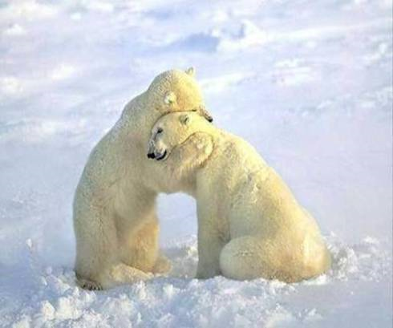
Promote Attachment and Trust
Strategies need to be used with clients at every age to promote social and emotional development, attachment or trust, and problem solving skills to support easy transitions and post traumatic growth during and after a stressful event or series of events

Slide 76
Relationship Building
Interventionists have the ‘power’ to reach these children and teach them new skills. They have the ability to build and form relationships and attachments; to empower these clients and make them feel secure. You have the ability to create new chapters in a person’s life.

Slide 77
Adverse Childhood Experiences
The ACE Study findings suggest that certain experiences are major risk factors for the leading causes of illness and death as well as poor quality of life in the United States.
17,421 adult members of a large HMO,
44 percent of respondents reported suffering sexual, physical, or psychological abuse as children, and
12.5 percent reported domestic violence in the home.

Slide 78
Adverse Childhood Experiences
Child physical abuse
Child sexual abuse
Child emotional abuse
Neglect
Mentally ill, depressed, or suicidal person in the home
Drug addicted or alcoholic family member
Witnessing domestic violence against the mother
Loss of a parent to death or abandonment, including abandonment by parental divorce
Incarceration of any family member.
What’s Missing???

Slide 79
ADVERSE CHILDHOOD EXPERIENCES (ACEs)
LIFE LONG PHYSICAL, MENTAL & BEHAVIORAL OUTCOMES OF ACEs
Alcoholism & alcohol abuse
Chronic obstructive pulmonary disease & ischemic heart disease
Depression
Fetal death
High risk sexual activity
Illicit drug use
Obesity
Sexually transmitted disease
Smoking
Suicide attempts
Unintended pregnancy
Intimate partner violence
Liver disease
The higher the ACE Score, the greater the incidence of
co-occurring conditions from this list.

Slide 80
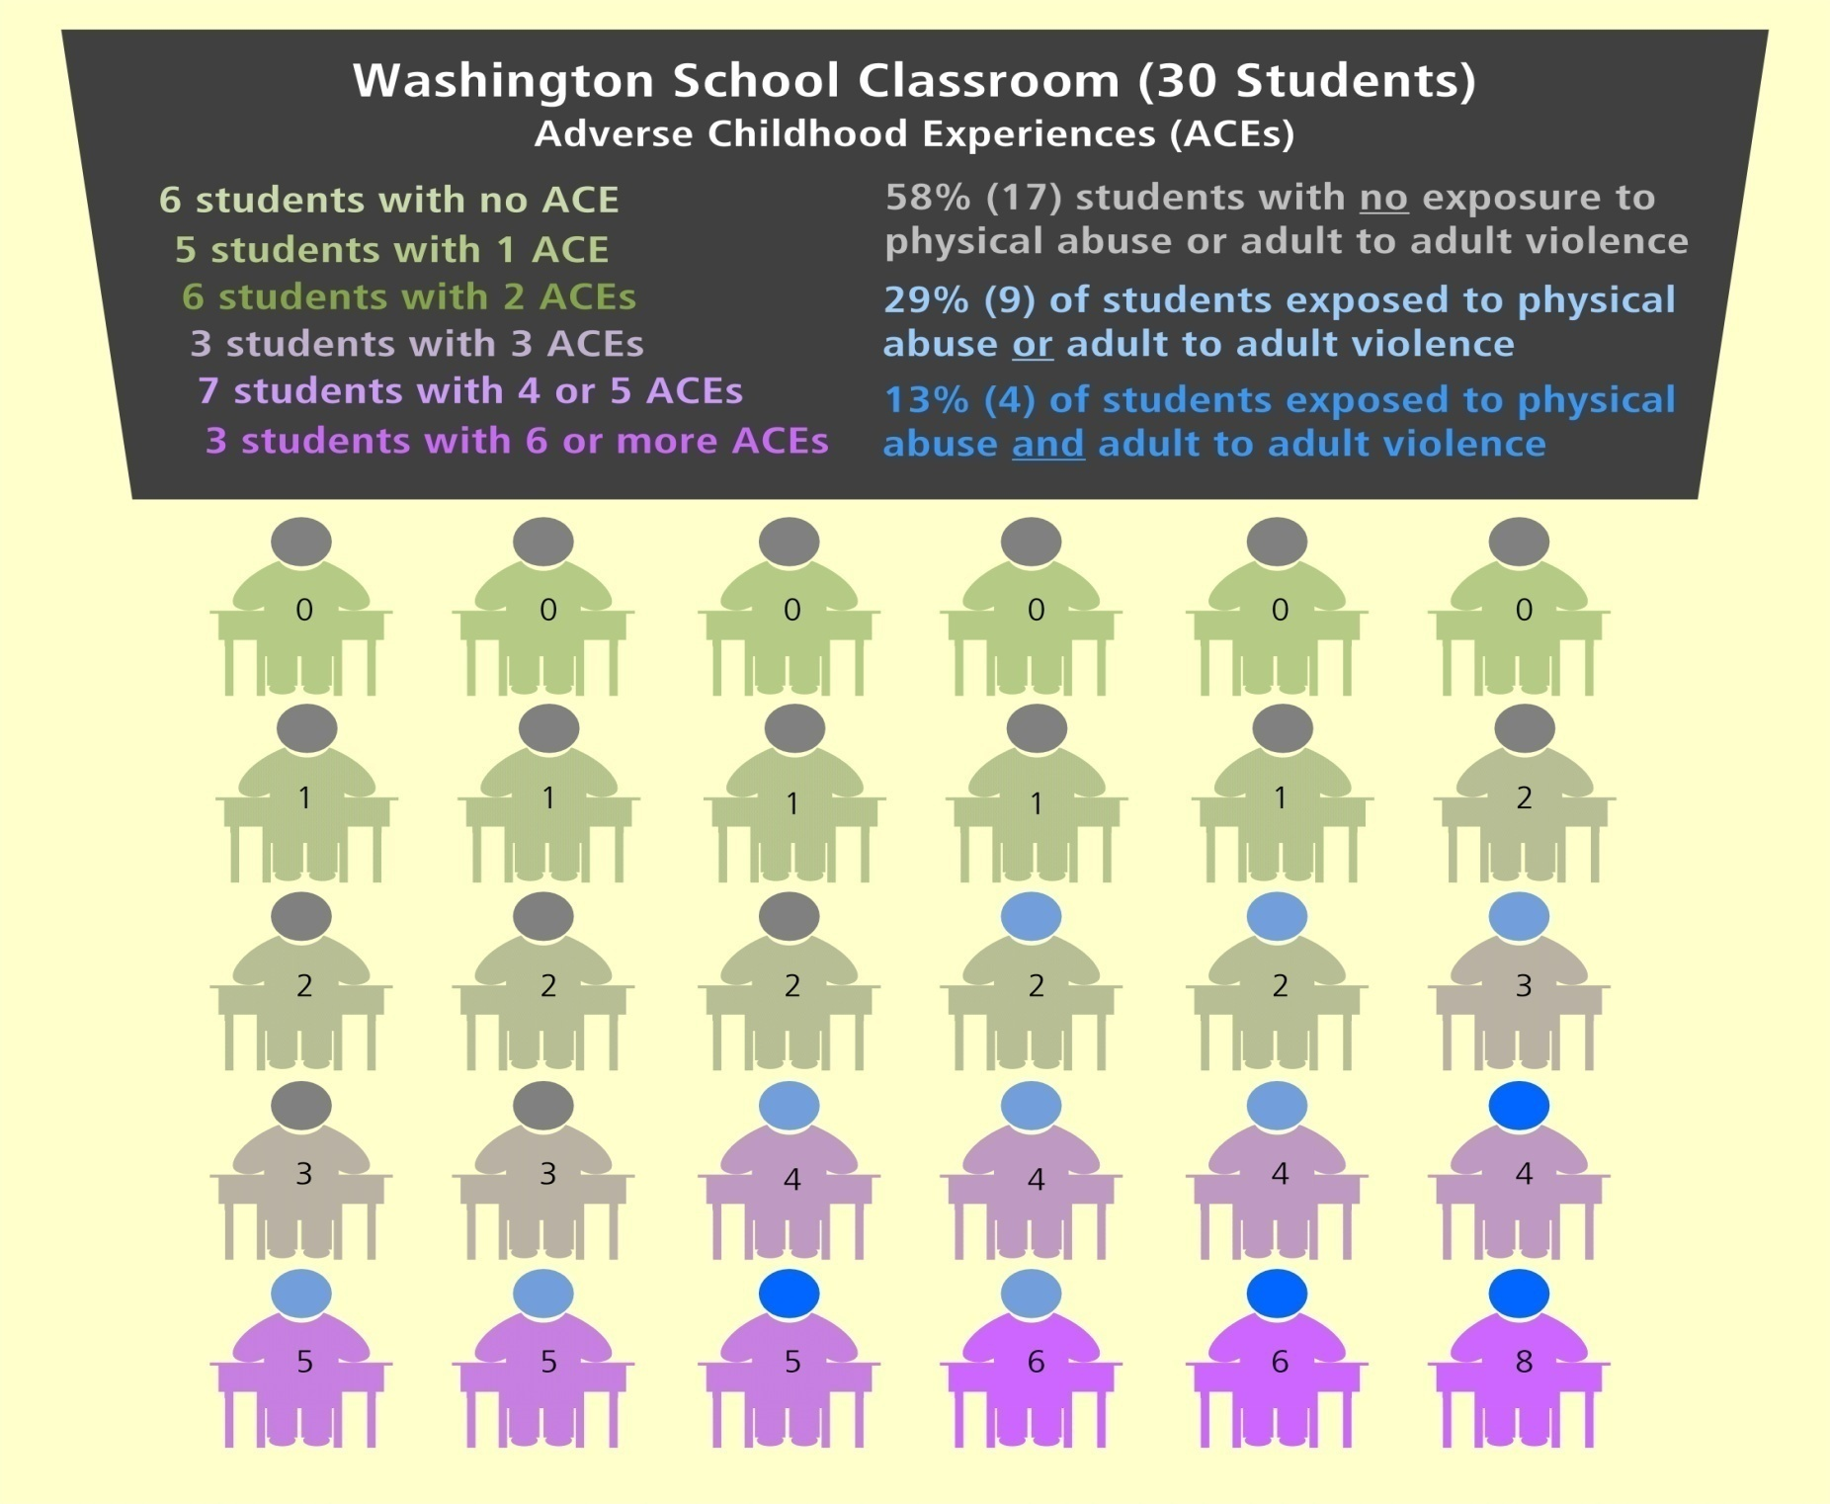
ACEs in WASHINGTON SCHOOLS – SOPHOMORES AND SENIORS
(2010)

Slide 81
Pro-Social Instruction in the Schools
An Ounce of Prevention is worth a pound of treatment
Emotional foundations were established at home
Not always the case now as children spend more of their early years in formal educational environments
The responsibility of social skills and behavior training has fallen on the educational system
CSEFEL csefel.vanderbilt.edu/
PBIS www.pbis.org/school

Slide 82
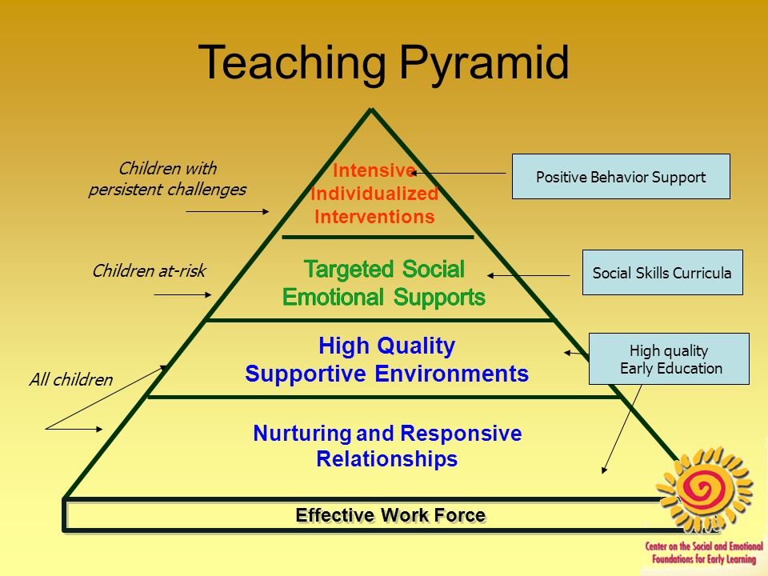

Slide 83
Compassionate Schools Washington State Department of Education
Instructional methods/Principles
Always Empower
Provide unconditional positive regard
Maintain high expectations
Check assumptions, observe, question
Be a relationship coach
Provide guided opportunities for helpful participation

Slide 84
Compassionate Schools Washington State Department of Education
Instructional content/domains
Safety, connection and assurance,
Improving emotional and behavioral self-regulation
Competencies of personal agency (the belief that a child can make things happen), social skills and academic skills (including executive functioning)

Slide 85
Student Centered Discipline and Social Emotional Learning
Although these techniques look at the student learning outcomes, they are built around a teacher evaluation framework.
Designed for schools-applicable to home
Social Emotional Learning is the educational process that focuses on development of social-emotional competencies, which are the skills, behaviors, and attitudes children need to effectively manage their affective, cognitive, and social behavior. (Yoder 2014)

Slide 86
Addressing the Whole Child Yoder-2014
Student Centered Discipline
Teacher Language
Responsibility and Choice
Warmth and Support (Teacher and Peer)
Cooperative Learning
Classroom Discussions
Self-Reflection and Self-Assessment
Balanced Instruction
Academic Press and Expectations (Stand and Deliver)
Competence Building-Modeling, Practicing, Feedback, Coaching

Slide 87
5 Social Emotional Competencies
Self awareness-The ability to recognize own feelings interests and strengths
Self-management-The ability to handle daily stresses and control emotions in demanding situations
Social awareness-The ability to take other’s perspectives into account, the ability to empathize
Relationship management-The ability to develop and maintain healthy social relationships, resist negative pressure, resolve interpersonal conflict and access help
Responsible decision making-The ability to balance multiple factors-such as ethics, standards, and safety-problem identification and solution management

Slide 88
Effective Tips for Challenging Behaviors

Slide 89
Two Categories of Tantrums (Green 2011)
Both represent strong emotions
Screaming and Yelling
Anger related
Crying, Fussing, Whining
Sadness, distress, comfort seeking

Slide 90
Screaming and Yelling
Two tips
State in positive terms exactly what you would like the child to do with his anger.
Turn the rage into constructive action
Turn the brain on
Engage in a motor and cognitive activity that turns the brain on- Focus on action TO DO- not STOP---! If your correction starts with STOP or NO, you are focusing on the negative (Limited thinking space)

Slide 91
Tantrums Crying, Fussing Whining
Practice crying, fussing and whining and then gaining control.
When the child is in a non-tantrum state, role play a tantrum episode with the adult as the tantrumer, give the child a script to read. (reinforced practice)
Use picture prompts (what to do!)
Provided effective stimulus prompts to guide the child and to combat negative reinforcement during demand situations”
Provide the child with:
alternative ways of accessing help
brief breaks from demands
increased motivation to comply by manipulating
reinforcement contingencies

Slide 92
Non-Compliance
Carefully define initial measurement of compliance
Categories of Intervention
Reduce response effort with reinforcement and prompting
Fade supports increase effort required
Interventions need to be individualized, what works for one does not work for all

Slide 93
Impacting Refusal
Break tasks into smaller parts
Teach sequencing
Teach the expectation you want the child to internalize (repetition is needed)
Reduce emotional noise-minimize adverse facial expressions, tone of voice, proximity
Start with control fade to reasoning and internalizing,
Teach negotiating as social problem solving

Slide 94
Running Away/Elopement
Collect evidence to determine cause-
Is running away or running toward?
Simply enjoys running or exploring
Is trying to reach a place he/she enjoys (such as the park)
Is trying to escape an anxious situation (like demands at school)
Is pursuing his/her special topic (as when a child fascinated by trains heads for the train tracks)
Is trying to escape uncomfortable sensory stimuli (like loud noise)

Slide 95
What is the Opposite of Running Away?
Depends on the reason for running away.
Engagement
Behavioral, cognitive and affiliation
The behavior of running away will continue unless the underlying cognitive and affiliate components are not addressed

Slide 96
Engagement
Behavioral
Reinforce engaged behavior,
Cognitive
Teach emotional regulation
Relevance of task to goals
Explicit value of engagement
Teach strategy for obtaining goal
Affiliative, nature of relationship
Belonging (peer expectations)
Identification with person and class
Membership

Slide 97
Prevention Strategies
Change
Triggers
Setting event exposure
Positive consequences
Intent
Make environment
More pleasant
More agreeable
Less agitating
TEACH ANGER MANAGEMENT! (Emotional Intelligence)

Slide 98
Anger Management
Substance Abuse and Mental Health Services Administration (SAMSHA)
Free Work Book and Manual http://kap.samhsa.gov/products/manuals/pdfs/anger1.pdf
Anger management manual and participants workbook
Easy to transfer to educational settings
Anger Control Plans
The Aggression Cycle
Assertiveness and Conflict Resolution

Slide 99
Special Populations Divorce/Separation
Most children have short term intense reactions with long term adjustment
Facilitate adjustment
Parents reduce exposure to conflict
Teach problem solving and social skills
Confront child’s attempts to distract and avoid feelings and reactions
Separation is not abandonment

Slide 100
Special Populations Abuse Supporting and Educating Traumatized Students
Change the conversation from “what is wrong with you” to “what happened to you”
Move from symptom relief to competency building
Give choices which improves child’s perception of control
Provide opportunities for success
Attack feelings of poor self worth

Slide 101
Special Populations Neglect Supporting and Educating Traumatized Students
Neglect has a more devastating impact than abuse
Neglect has a higher mortality rate than abuse
Use psychobiology principals to guide interventions
Primary idea is that the brain is use dependent
Differentiate based on potential cognitive and language based delays

Slide 102
Parent Misbehavior Supporting and Educating Traumatized Students
8.3 million American children have immediate family members under correctional jurisdiction
Over 8 million children are living with a parent who is substance dependent
Therapy suggestions-
Directly address the secrecy and shame it can sometimes have a bigger impact than the event

Slide 103
Parent Misbehavior
Be familiar with the law and agencies working with the child and your reporting requirements
Three important affirmations to teach
You did not cause this
You are not responsible for fixing it
You are not alone
Be a valuable resource for pertinent information

Slide 104
Rise to the Occasion
BE THE ONE!

Slide 105
Final Questions and Comments

