Slide 1
Why Aren’t You Paying Attention? Influences and Outcomes
Robin Greenfield, Ph.D.
Center on Disabilities and Human Development
University of Idaho

Slide 2
Attention
What does attention look like for the children I work with?
What are the components that are part of “paying attention” for them?
What sustains their attention?
What impact does a distraction or an interruption have on their attention?
How is attention impacted by multi-tasking?

Slide 3
Agenda
Definitions of attention
Facts about attention
Biobehavioral states
Distractions and interruptions
Multitasking
Watch clips of children
Activities to look at your own attention

Slide 4
What is Attention?
“Attention … is the taking possession by the mind, in clear and vivid form, of one out of what seem several simultaneously possible objects or trains of thought, localization, concentration, of consciousness are of its essence. It implies withdrawal from some things in order to deal effectively with others, and is a condition which has a real opposite in the confused, dazed, scatter brained state which in French is called distraction, and Zerstreutheit in German.”

Slide 5
Another Definition
“ Attention is an intentional, unapologetic discriminator. It asks what is relevant right now and gears us up to notice only that.”

Slide 6
What Do We Know About Attention?
Begins in utero
Is anatomically separate from processing
systems
Attention and memory cannot operate
without one another
Has three major networks – alerting,
orienting, and executive attention

Slide 7
The Networks
Alerting - achieve and maintain a state of
high sensitivity to incoming stimuli
Orienting - selection of information from
sensory input (aligning with sensory
signal)
Executive Attention – orchestrating the
activity of sensory, cognitive, and
emotional systems (Posner, 2012)

Slide 8
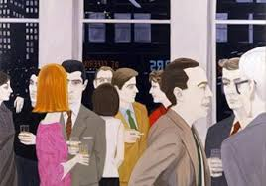
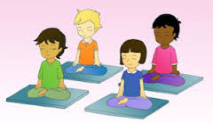
Different Kinds of Attention
Selective attention
Sustained attention
Divided attention

Slide 9
Impact on Attention
Biobehavioral state
Medication/Seizures
Environment and Instruction
* Topic
* Distractions
* Interruptions
Multi-tasking

Slide 10
Biobehavioral States
Deep sleep
Quiet sleep
Active sleep
Drowsy
Quiet awake
Active awake
Fussy awake
Mile agitation
Uncontrollable agitation

Slide 11
Joint Attention
Joint Attention – is an early-developing social-communicative skill in which two people use gestures/gaze to share attention with respect to interesting objects or events.
“The eye of the mind”
“I reached her inner ear”

Slide 12
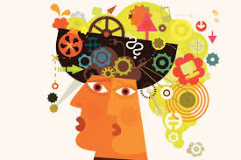
Distractions
A distraction is “something that makes it difficult to think or pay attention”

Slide 13
What do we know about distractions?
Distractions are interferences in the brain
Brain is sensitive to interference
Interference can be internal or external
Based on your goals
Challenging for children we serve

Slide 14
Interruptions
An interruption is …..
“to stop or hinder by breaking in”
“to break the uniformity or continuity of”
Interruptions are different than distractions

Slide 15
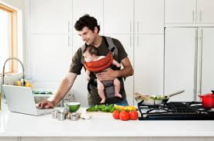
Multitasking
“The performance of multiple tasks at one time”

Slide 16
Round 1
Write the story of “Snow White”
While writing the story, count backwards in increments of “1” from 200. (200, 199, 198) OUT LOUD
You have 2 minutes
When asked to stop, write the number of words you wrote and what number you ended on

Slide 17
Round 2
1) Write the story of “Little Red Riding Hood”
* You have 2 minutes
2) Count backwards from 200
* You have 2 minutes
3) Write the number of words and the number you ended on

Slide 18
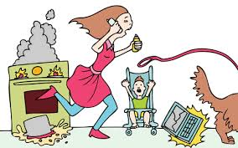
The Myth of Multitasking

Slide 19
Lessons Learned
Take the time to be a good observer
Understand what attention means for a child
Study the environment and the people in it
Look at your own pattern of attention and
the things that influence it

